Slide 1

Server Side Programming
Day Seven

Slide 2

Welcome!
Hazard Recognition Course​
Week 1- Summary​
Hazard Recognition Course​
Week 1- Summary​

Slide 3
Database Design fundamentals
When designing database tables, we want to treat things as “objects”.
This means separating things much like we do in real life, to attributes that describe something.
For example, a Person has a name, address and phone number.
If we wanted to give a Person multiple addresses, we could separate the Address into its own “object” and relate it to the Person.

Slide 4
Database Design fundamentals
Relationships between objects in a database are managed by their “ID” or primary key.
The primary key identifies the record uniquely within the table it is in.
The Person with ID = 1 would match up to any Address objects that have a personID = 1
This helps to keep our databases clean, without redundant data.

Slide 5
Database Design fundamentals
If we simply made two rows for the same person when referencing two addresses (such as one for billing and one for shipping), then we would have duplicate data.
The duplicate data would be the Person object data that is not related to an Address.
This makes a database larger in size and more difficult to navigate.

Slide 6
Database Design fundamentals
Duplicate data should be avoided when possible since that data all needs to be updated separately.
Because of this, the data might contain errors.
When trying to figure out statistics about a specific Person, for example, how many addresses they have, you might not get the correct results.

Slide 7
Database Design fundamentals
Breaking data down into smaller more logical parts for a database is called “normalization”
This helps us separate “classes” in the database, which we use as tables.
A person, for example has a name, dob, and hair color.
A person can also have 2 addresses.
Rather than have two person records with two addresses, we can split the addresses into their own table.
Then we can have one person record linked with two addresses.

Slide 8
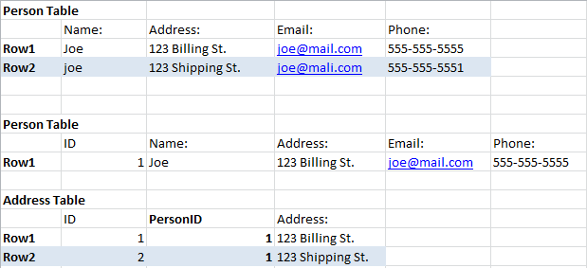
Database Design Fundamentals
In this example, it is hard to tell which Joe we should be referencing, the Joe with capital J or joe with lower case j.
By separating the Addresses from the Persons, we can keep the records straight.

Slide 9
Database Design fundamentals
DEMO Restore database school.sql
Examine the layout of the database and how things are organized.

Slide 10
SQL Syntax Explored
SQL syntax is a separate language from PHP, HTML, or CSS.
It is often displayed in CAPITAL letters for SQL keywords.
You can run SQL syntax in the command line window or through the GUI in phpMyAdmin.

Slide 11
SQL Syntax Explored
We will text running a basic SQL query in the GUI.
The query we will run is a SELECT statement. This is the most basic query we generally will run.
The SELECT statement is used to look up data.
IE – SELECT COLUMNS FROM TABLENAME

Slide 12
SQL Syntax Explored
SELECT is the type of query
COLUMNS is a list of columns to be selected for the query. These can be all using the * character, or individual ones using the column names.
“FROM TABLENAME” points to the specific table we want to run the query against.

Slide 13
SQL Syntax Explored
SELECT * FROM Person – selects all rows and columns from the Person table
SELECT name, email FROM Person – selects all rows and just the name and email columns from the Person table.

Slide 14
SQL Syntax Explored
As a best practice, it is good to be specific and select only the rows you need, as this could expose data (such as a password or other sensitive personal information) to a hacker if your code is not completely secure.
No computer system will ever be 100% secure, so it is best to limit the columns you choose.
This also speeds up the query.

Slide 15
SQL Syntax Explored
Demo Basic SQL syntax.
select.sql
insertrecord.php

